Slide 1
Course Code: CSC211A Course Title: Formal Languages and Automata Theory
Session 20 :Normal Forms of Context Free Grammar -2
Course Leader:
Prakash P
prakashp.cs.et@msruas.ac.in

Slide 2
Session Objectives
At the end of this session, student will be able to
Explain pushdown automaton
Describe initial stack symbol
Understand non-determinism
Prove whether the given string is accepted by NPDA or not

Slide 3
Session Topics
Pushdown Automaton -- PDA
Initial Stack Symbol
Non-Determinism
NPDA Examples

Slide 4
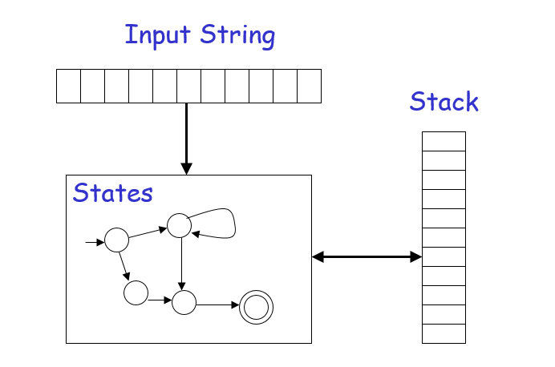
Pushdown Automaton -- PDA

Slide 5
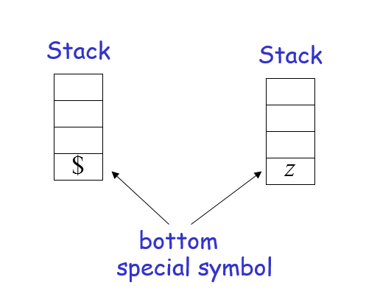
Initial Stack Symbol

Slide 6
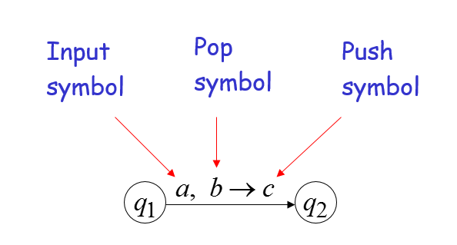
The States

Slide 7
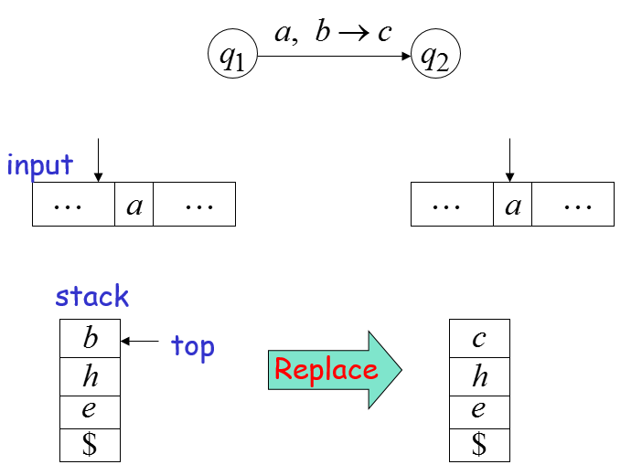
Pushdown Automaton -- PDA

Slide 8
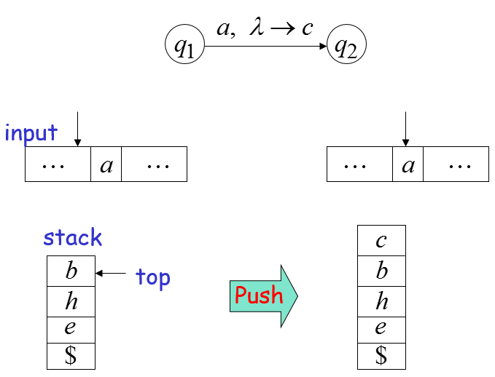
Pushdown Automaton -- PDA

Slide 9
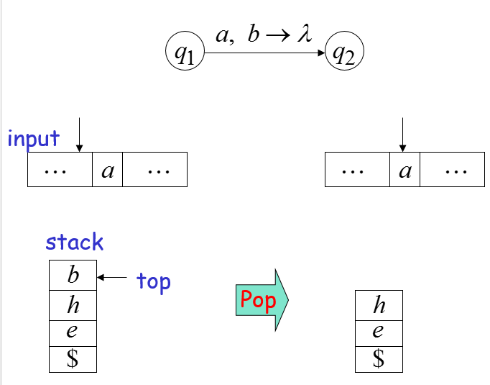
Pushdown Automaton -- PDA

Slide 10
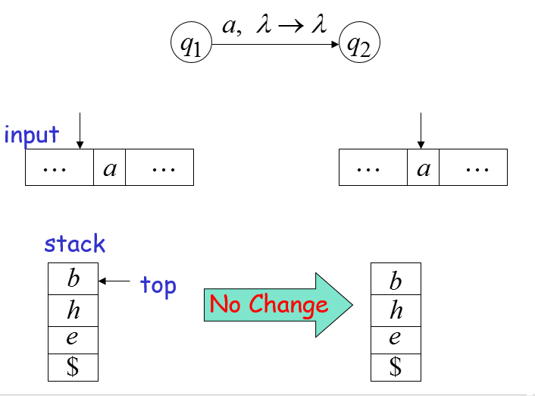
Pushdown Automaton -- PDA

Slide 11
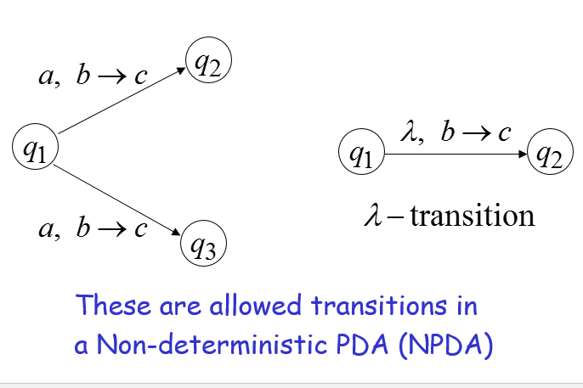
Non-Determinism

Slide 12
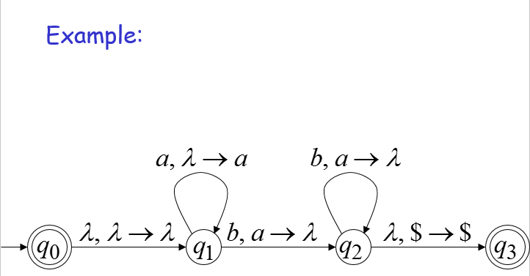
NPDA: Non-Deterministic PDA

Slide 13
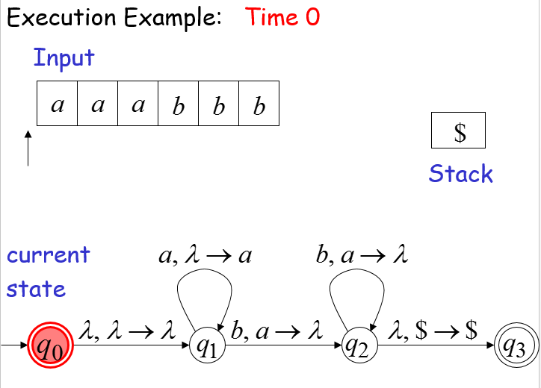
Non-Determinism

Slide 14
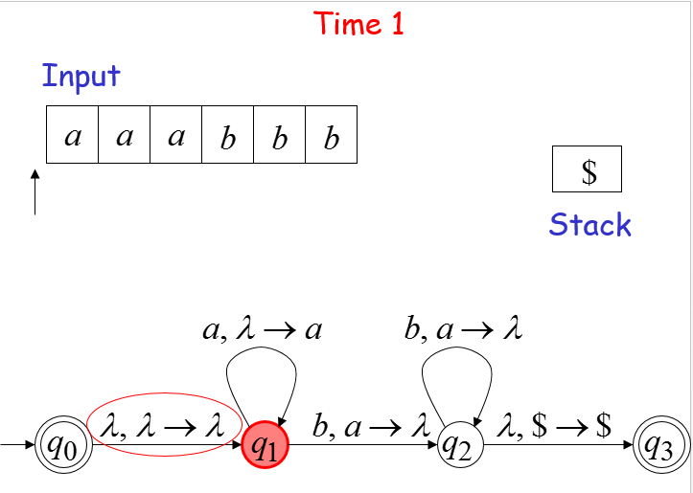
Non-Determinism

Slide 15
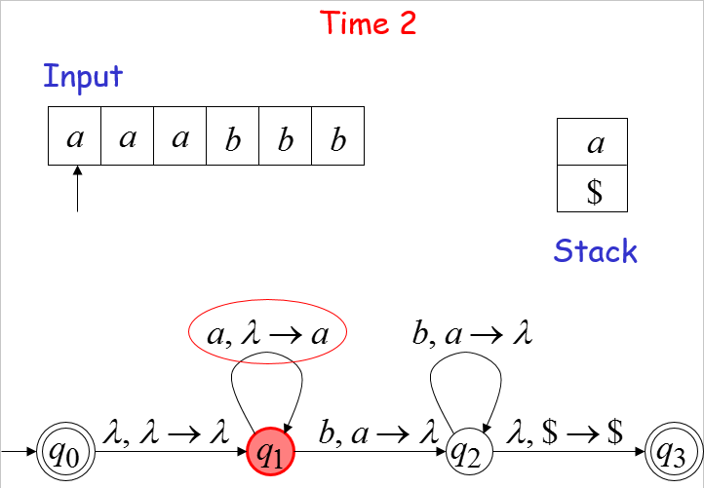
Non-Determinism

Slide 16
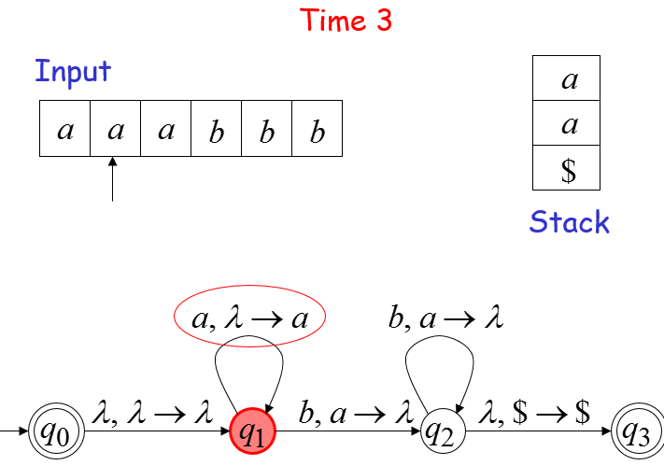
Non-Determinism

Slide 17
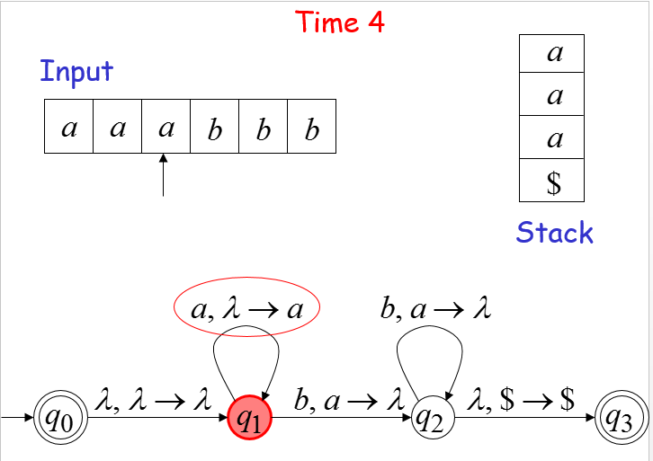
Non-Determinism

Slide 18
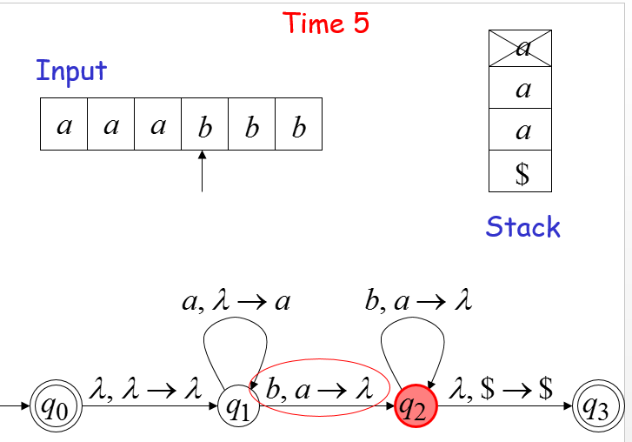
Non-Determinism

Slide 19
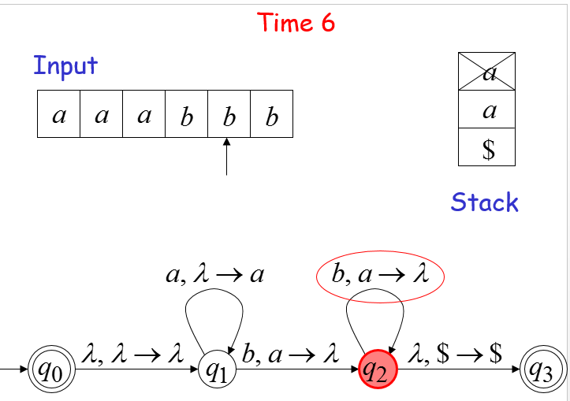
Non-Determinism

Slide 20
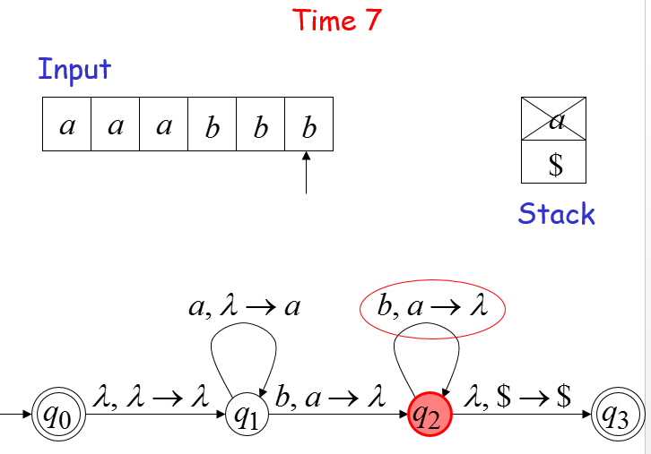
Non-Determinism

Slide 21
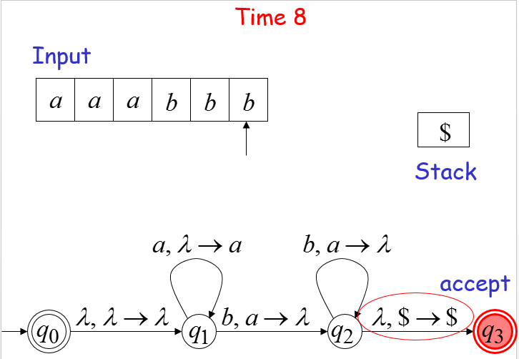
Non-Determinism

Slide 22
Non-Determinism
A string is accepted if there is a computation such that:
All the input is consumed
The last state is a final state
At the end of the computation, we do not care about the stack contents

Slide 23
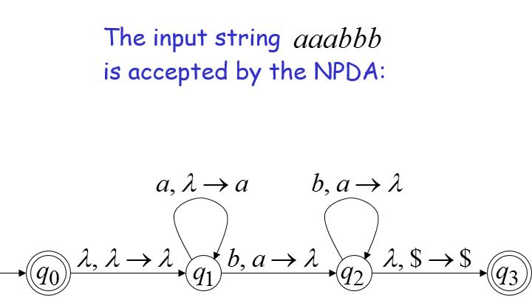
Non-Determinism

Slide 24
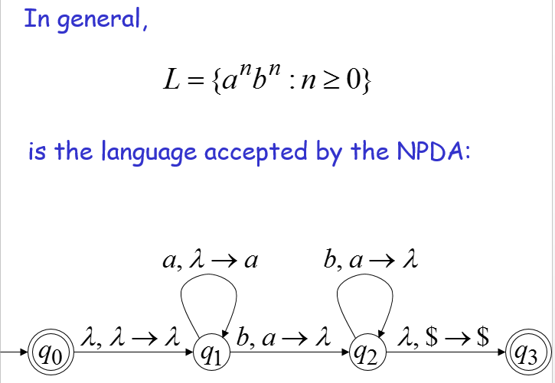
Non-Determinism

Slide 25
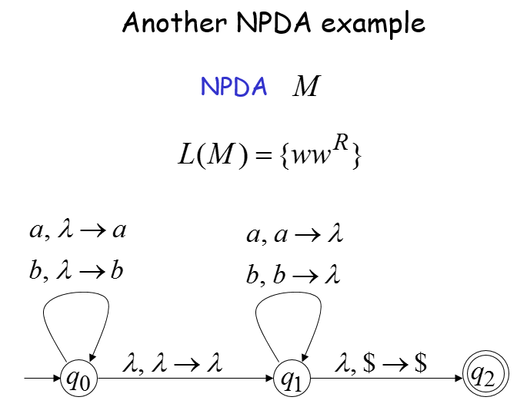
Another NPDA example

Slide 26
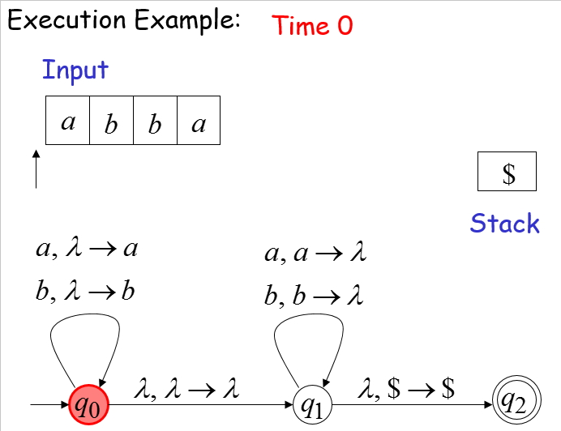
Non-Determinism

Slide 27
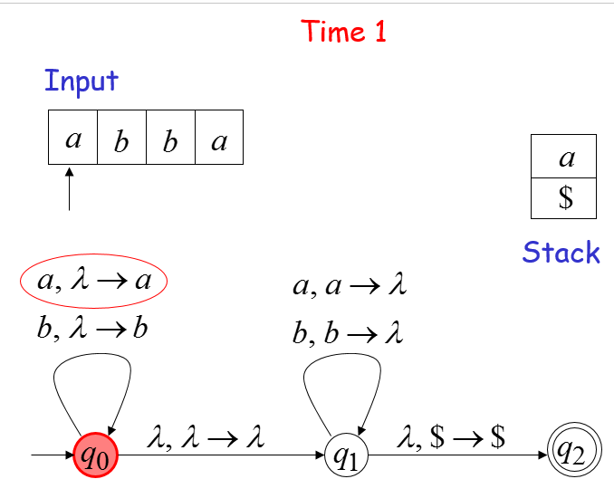
Non-Determinism

Slide 28
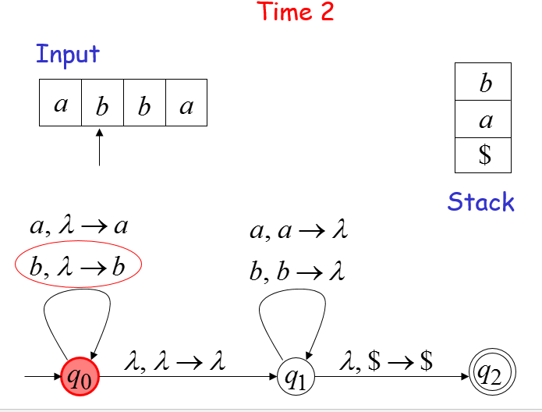
Non-Determinism

Slide 29
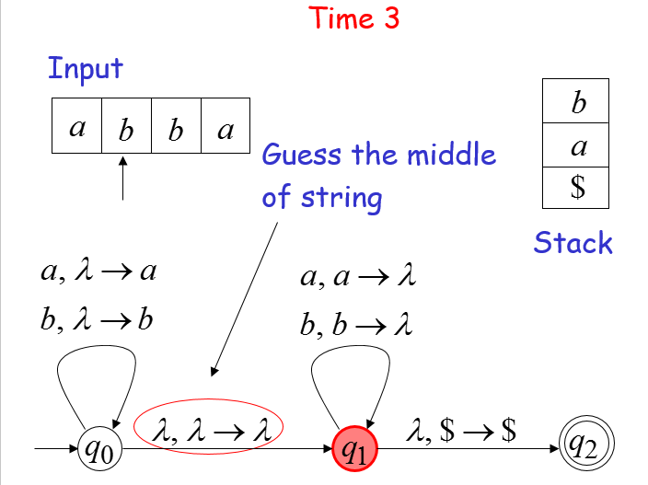
Non-Determinism

Slide 30
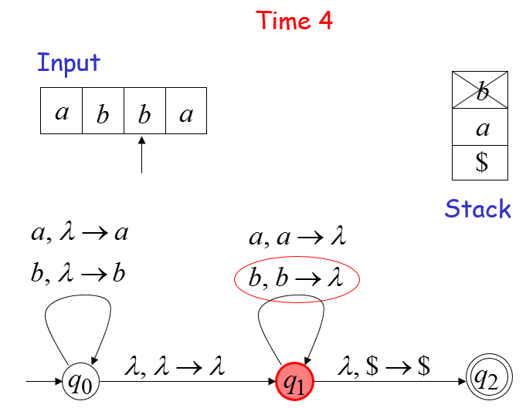
Non-Determinism

Slide 31
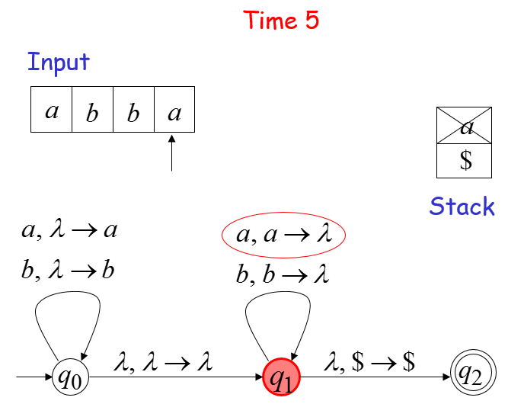
Non-Determinism

Slide 32
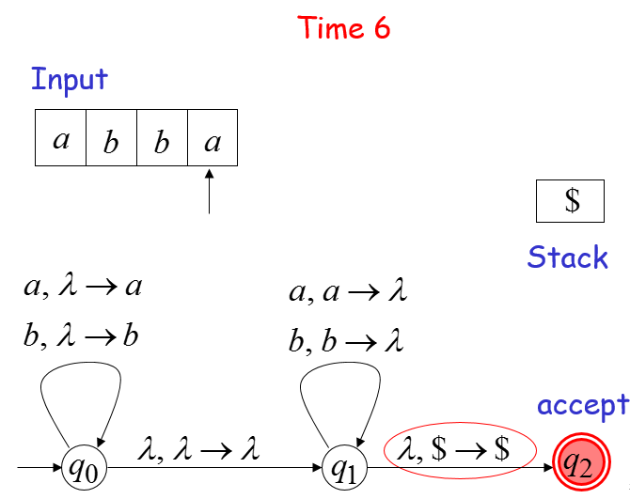
Non-Determinism

Slide 33

Non-Determinism

Slide 34
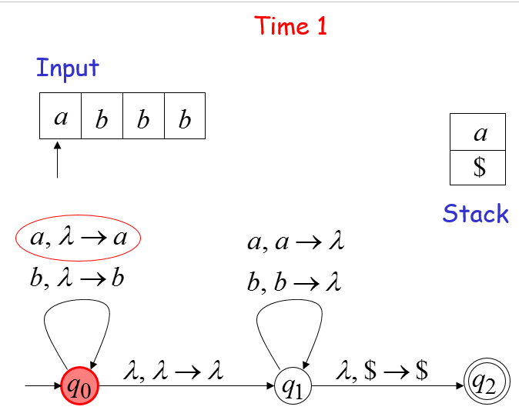
Non-Determinism

Slide 35
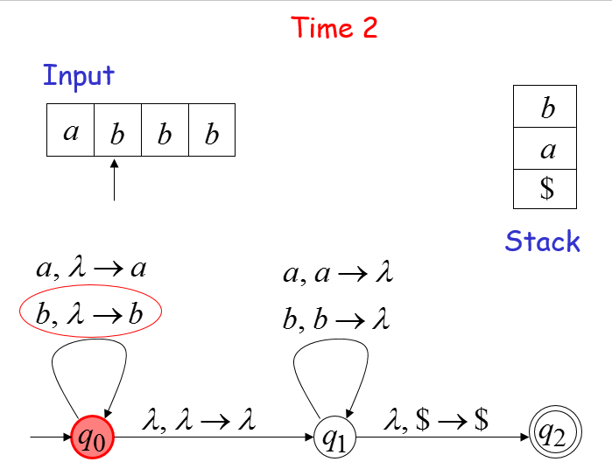
Non-Determinism

Slide 36
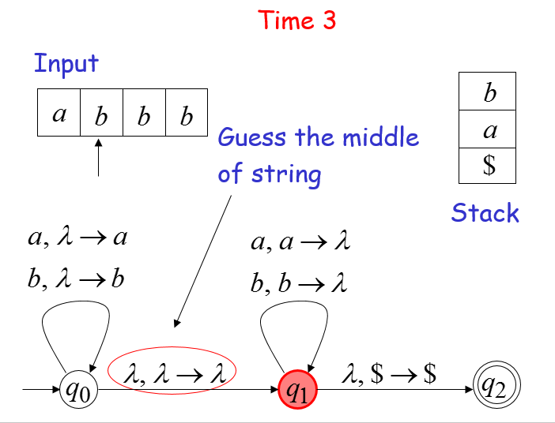
Non-Determinism

Slide 37
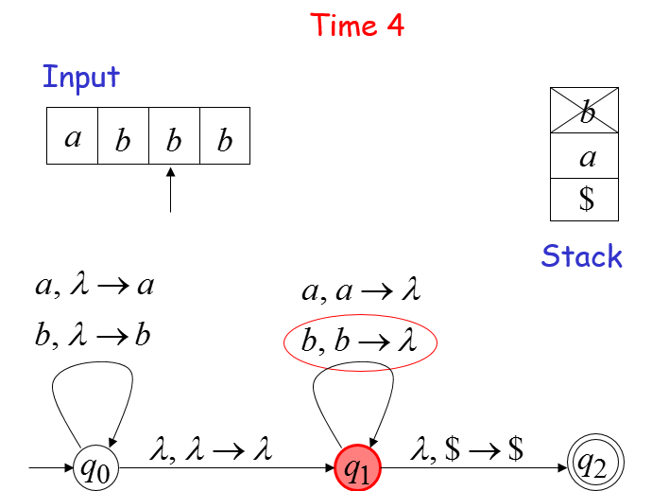
Non-Determinism

Slide 38
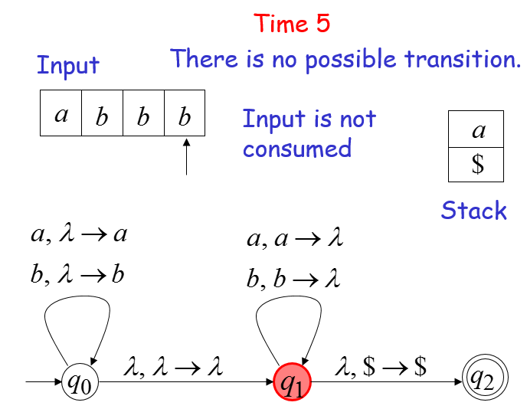
Non-Determinism

Slide 39
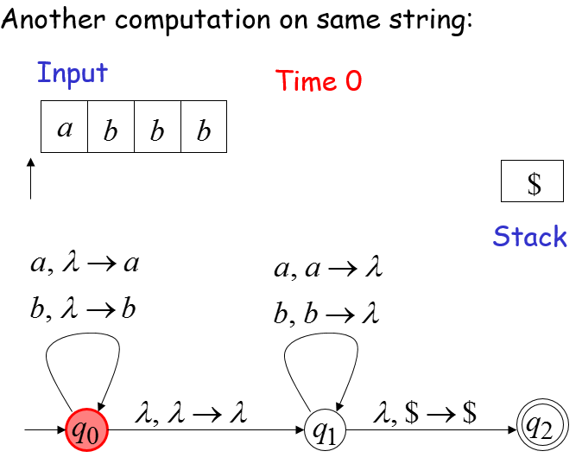
Non-Determinism

Slide 40
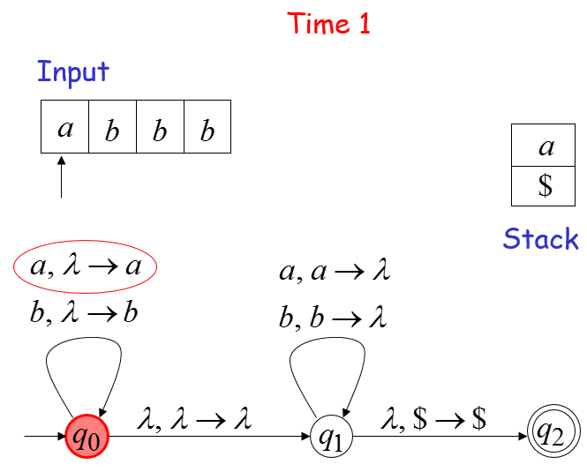
Non-Determinism

Slide 41
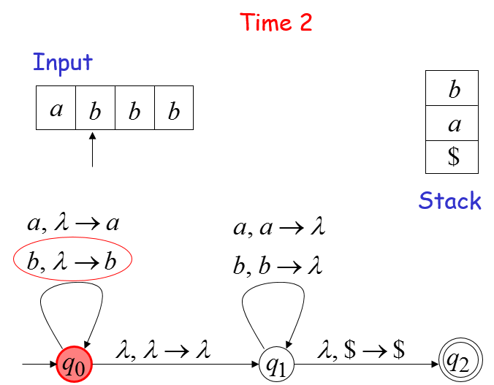
Non-Determinism

Slide 42
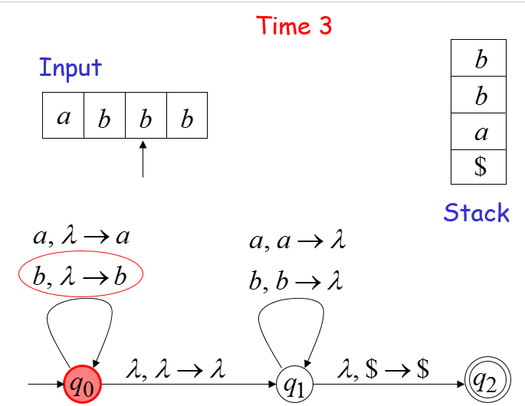
Non-Determinism

Slide 43
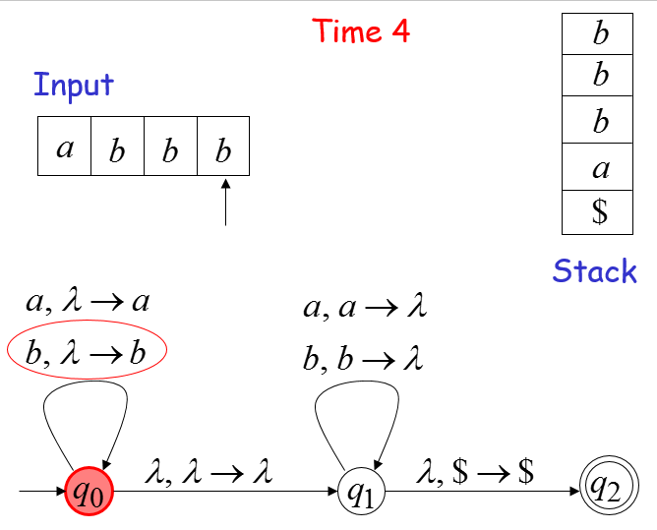
Non-Determinism

Slide 44
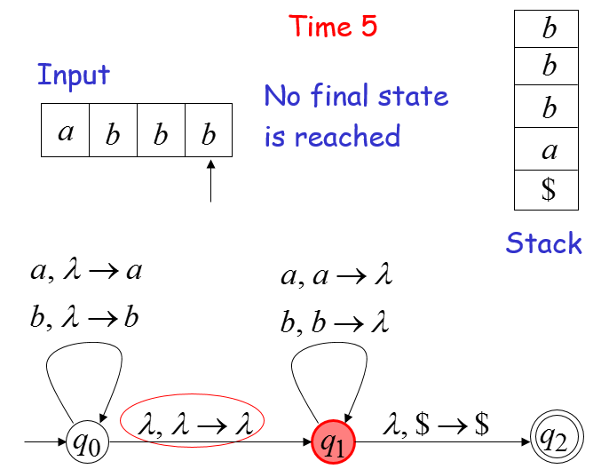
Non-Determinism

Slide 45
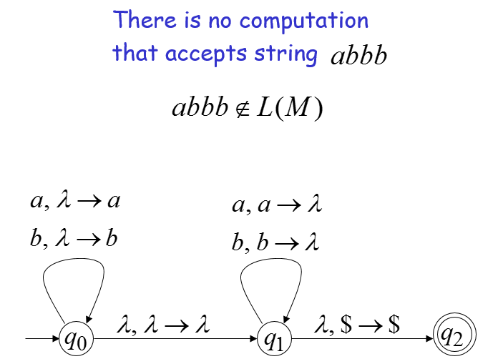
Non-Determinism

Slide 46
Summary
A string is accepted if there is a computation such that all the input is consumed and the last state is a final state

